Slide 1
Agenda
DNA- World War II Timeline
Notes: WWII in the Pacific
Paragraph Writing: Dropping the Atomic Bombs
World War II Graphs
Interactive Notebook Time

Slide 2
DNA World War II Timeline
Directions: Add the following events to your World War II Timeline in your interactive notebook.
July 10, 1943- U.S. and British troops land on Sicily.
June 4, 1944- Allied troops liberate Rome
June 6, 1944- D-Day
October 20, 1944- U.S. troops land on the Philippines. MacArthur returns.
May 1945- Allied Troops conquer Okinawa
August 6, 1945- U.S drops Atomic Bomb on Hiroshima
August 9, 1945- U.S. drops Atomic Bomb on Nagasaki.

Slide 3
Notes: World War II in the Pacific

Slide 4
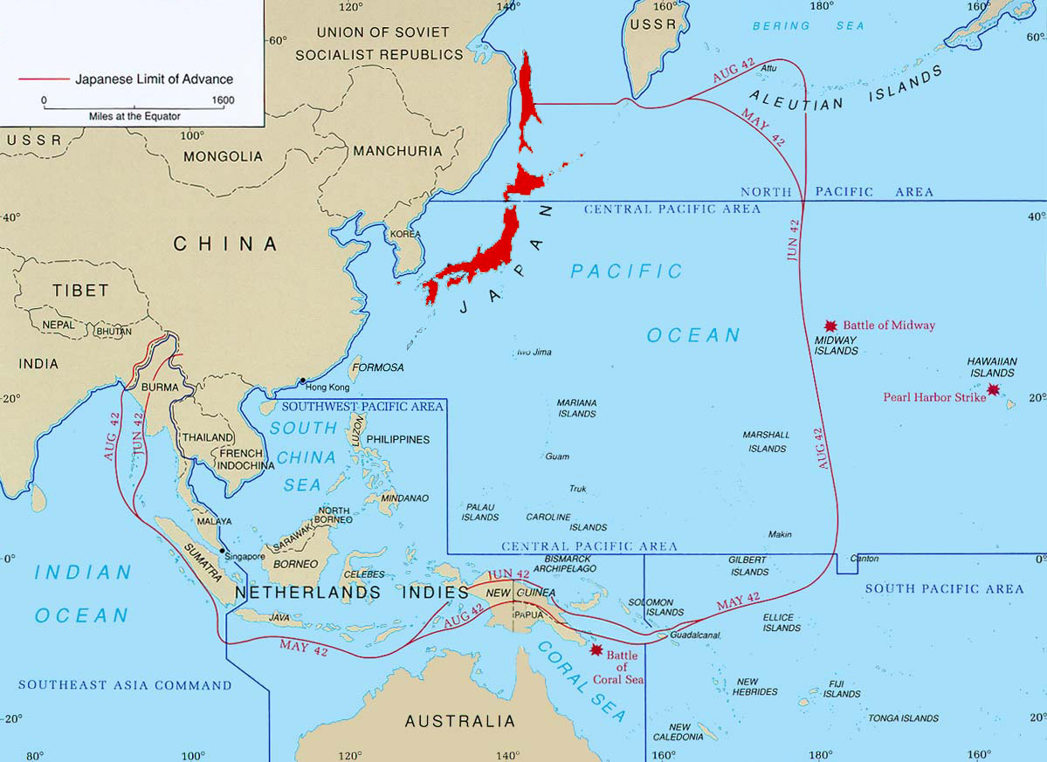
Prewar

Slide 5
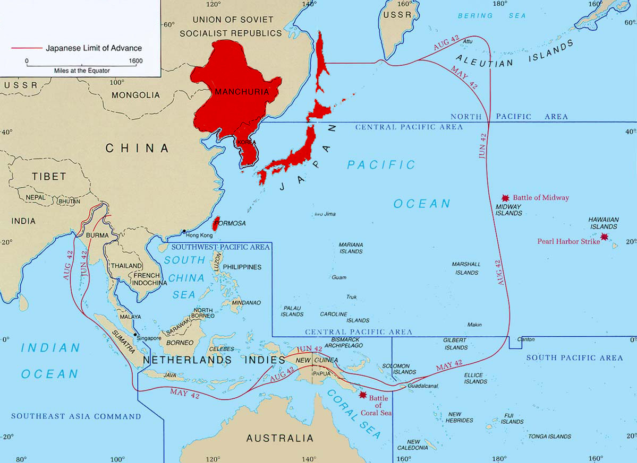
1932

Slide 6
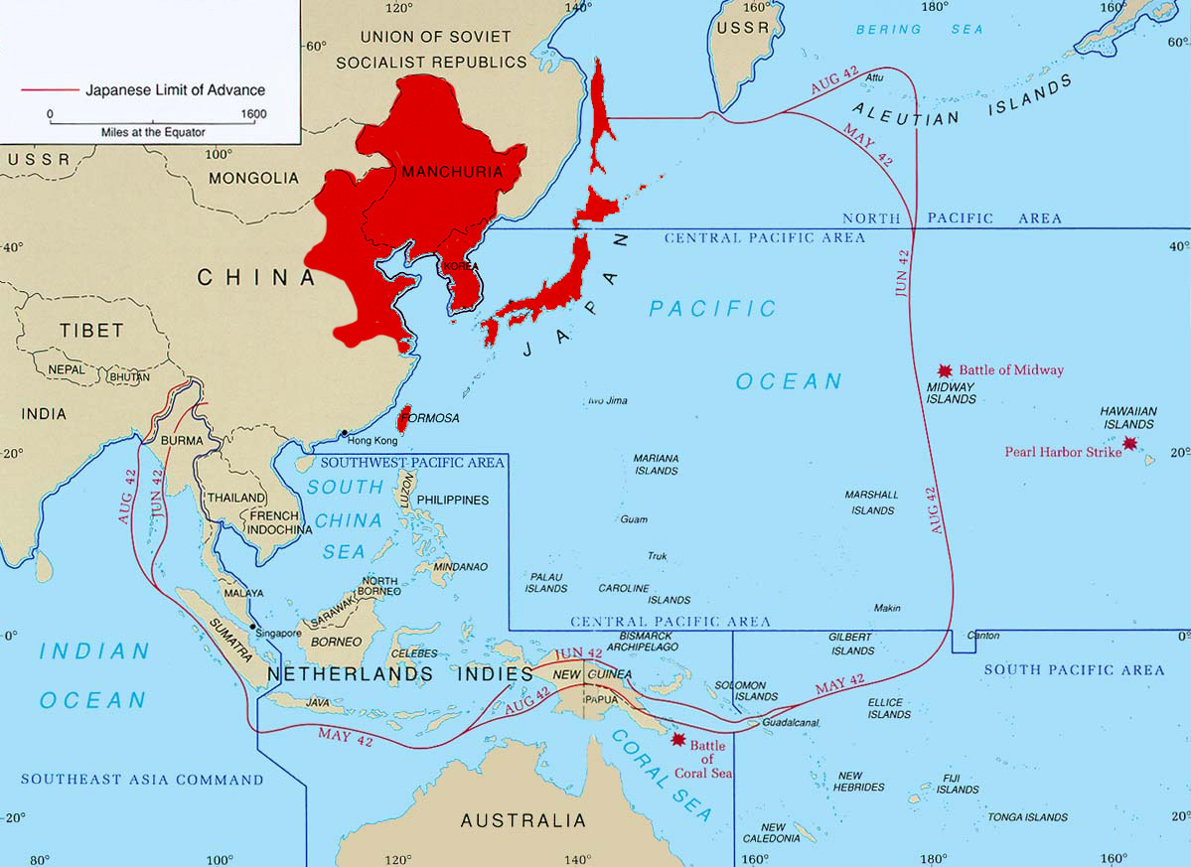
1937

Slide 7
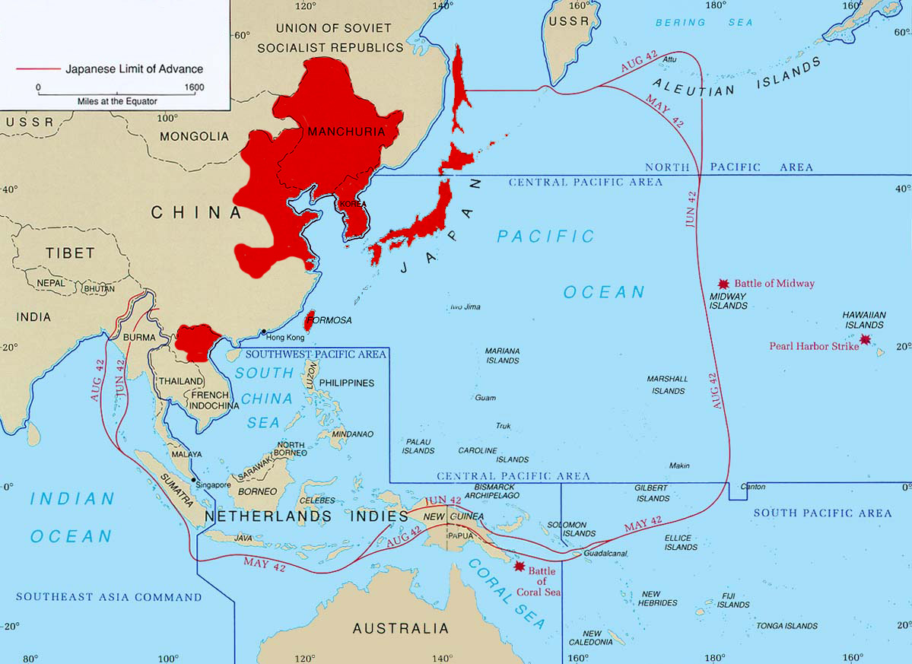
1940

Slide 8
1941
Notes:
Dec 8/7 1941 (simultaneous, but Int’l date line skews date)
Attacks on British Territory (Hong Kong) and American Territory (Pearl Harbour)

Slide 9
Early in the Pacific
December 7, 1941- Japan attack U.S. forces at Pearl Harbor causing the United States to declare war on Japan.
Roosevelt and the Allies determine the main threat is Hitler and he should receive the majority of the attention.
Battle of Midway June 1942- Significant because the Allies stop the advancement of Japanese forces. Turn Japan from offensive war to defensive war.

Slide 10
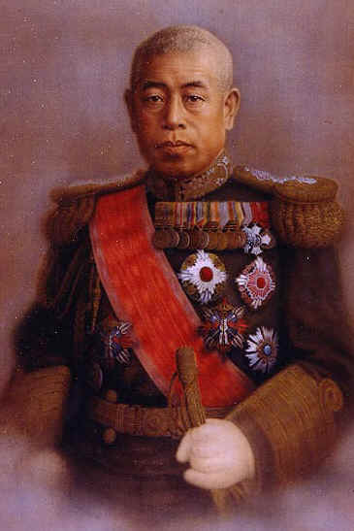
Fleet Admiral Yamamoto
“The US fleet is a dagger pointed at our throat and must be destroyed.”
“I can run wild for six months,after that, I have no expectation of success.”
- Yamamoto, during discussions on the planned Pearl Harbour Attack
Fleet Admiral Isoroku Yamamoto

Slide 11
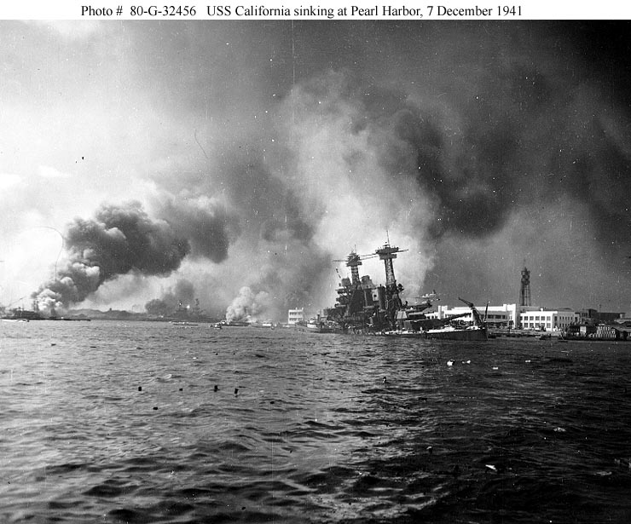
Attack on Pearl Harbor
Dec 7, 1941. “A day that will live in infamy”

Slide 12
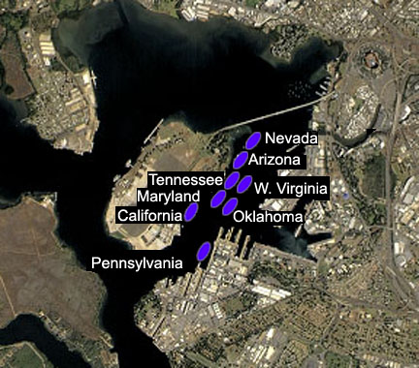
Pearl Harbor

Slide 13
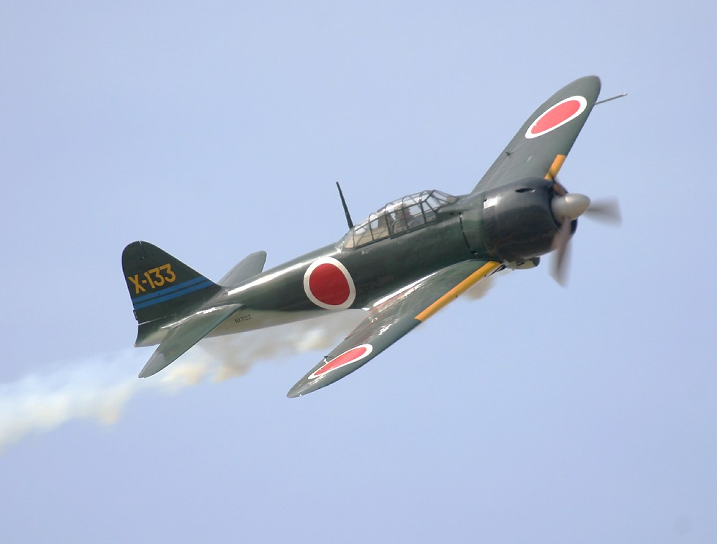
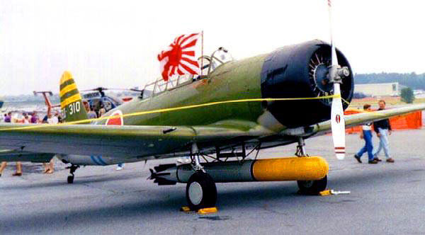
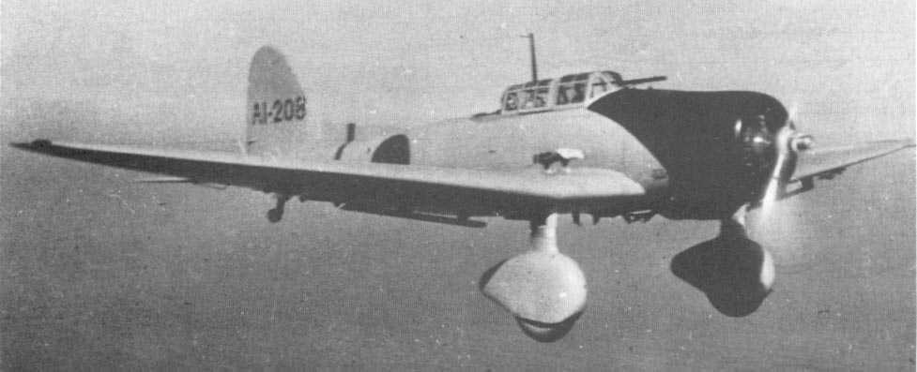
Japanese Aircraft
Mitsubishi A6M “Zero” Fighter
Nakajima B5N torpedo bomber
Aichi D3A dive bomber

Slide 14
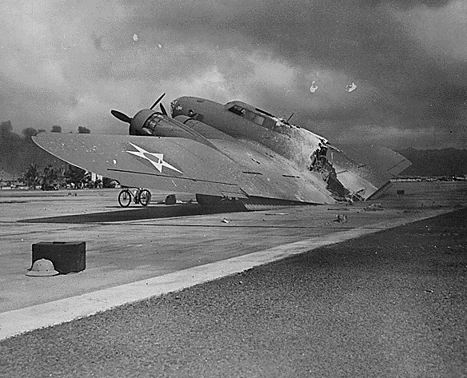
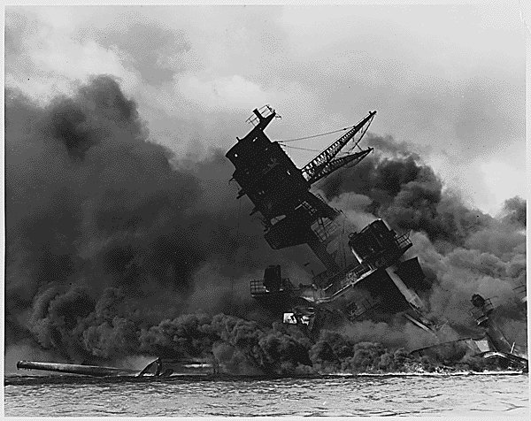
The Attack

Slide 15
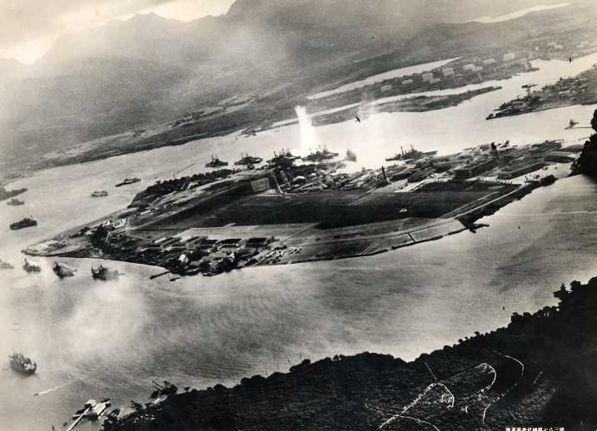
The Attack

Slide 16
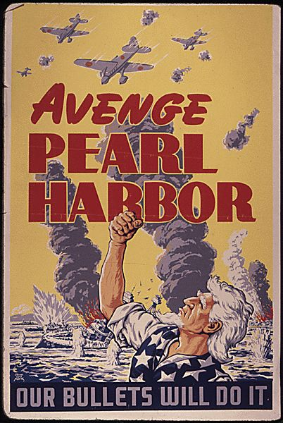
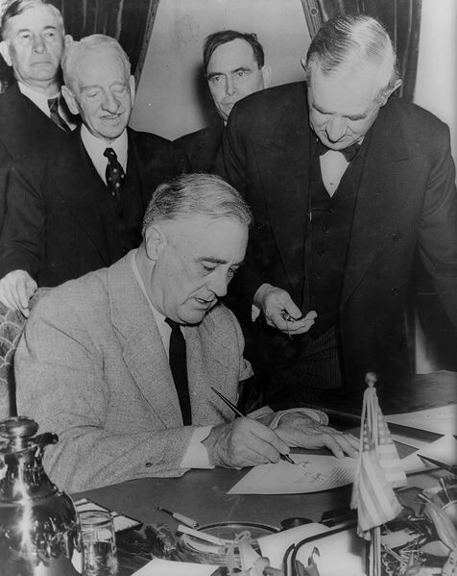
Aftermath
"Being saturated and satiated with emotion and sensation, I went to bed and slept the sleep of the saved and thankful.”
- Winston Churchill

Slide 17
1941
Notes:
Dec 8/7 1941 (simultaneous, but Int’l date line skews date)
Attacks on British Territory (Hong Kong) and American Territory (Pearl Harbour)

Slide 18
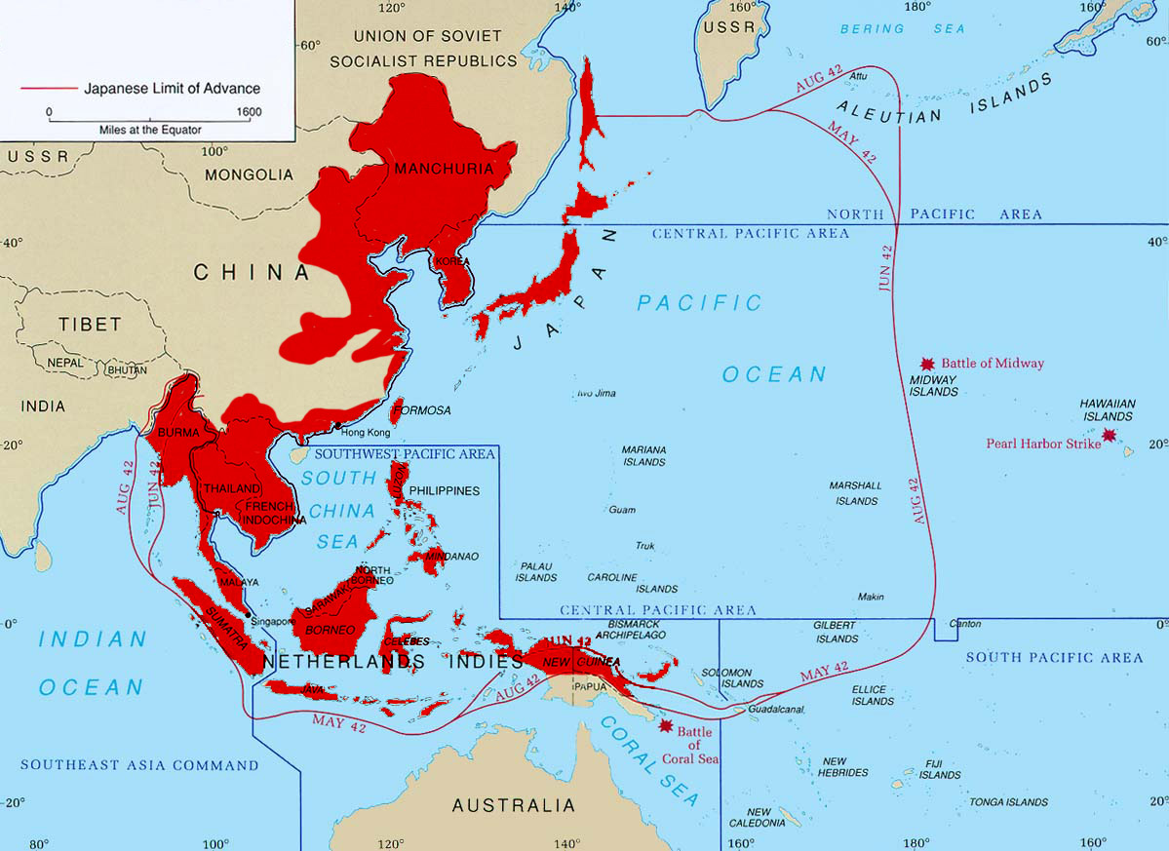
1942

Slide 19
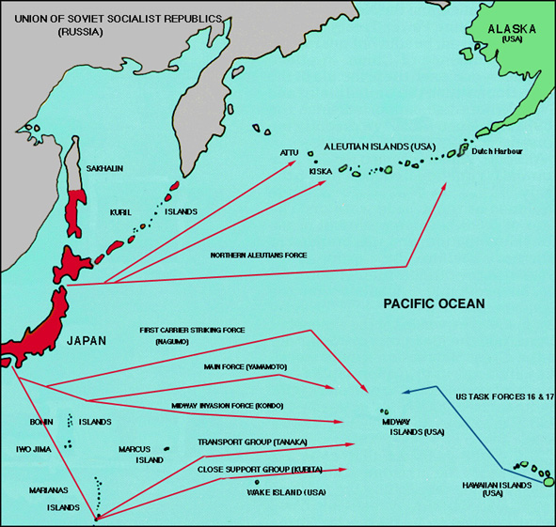
Plan of Attack

Slide 20
Fighting in the Pacific Video Clip
http://www.youtube.com/watch?v=dARSvPDoJag

Slide 21
World War II Reaction and Meetings
1942- The United States moves Japanese Americans into internment camps.
Tehran Conference November 1943- Churchill, Roosevelt, and Stalin agreed in opening a 2nd front in the war and decided future course of WWII for the Allies.
Yalta Conference February 1945- Churchill, Roosevelt, and Stalin agree the Germany would be demilitarized and denazified after the war, and that Nazi war criminals would be hunted down and put on trial
Potsdam Conference July 1945- Churchill, Stalin, and Truman couldn’t agree on how to rule Eastern Europe and issued ultimatum for Japanese surrender.

Slide 22
What fighting the The Pacific may have looked like.
http://www.youtube.com/watch?v=_uVOoqTAbNc

Slide 23
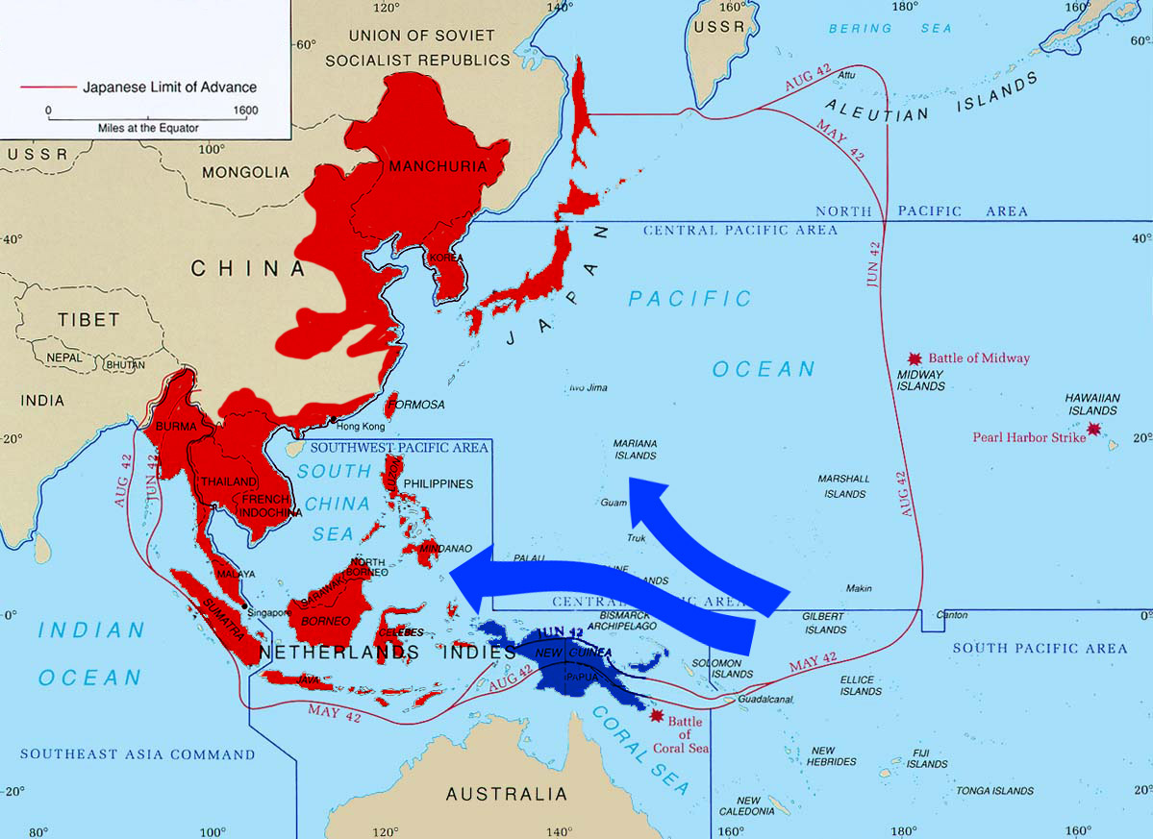
1943-1944
Notes:
American Offensives captured Guadalcanal, the Solomon Islands, And then Rabaul, the main base in Papua New Guinea
The push began to capture the Marianas cluster of islands, which would provide airbases to strike the main Japanese islands.

Slide 24
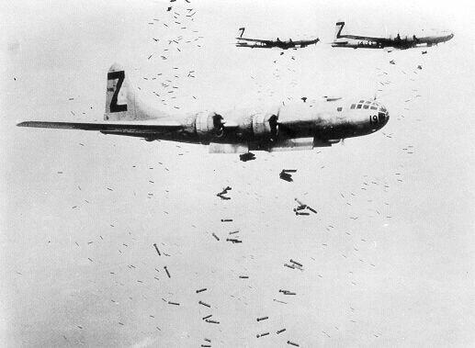
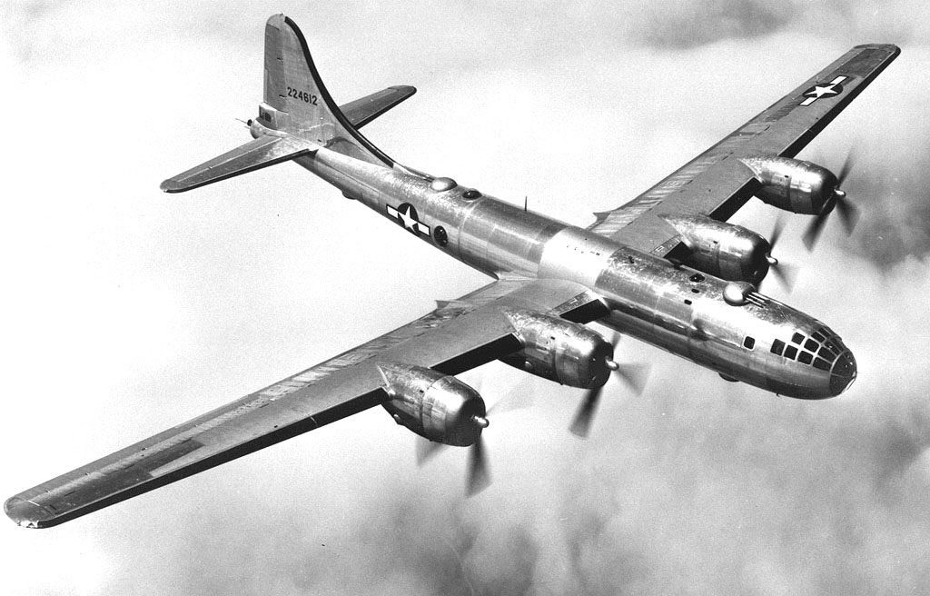
Strategic Bombing
B-29 Superfortress bombers
Notes:
High-altitude B-29 bombers could fly above fighter and artillery defenses and drop bombs with impunity. Explosives and incendiaries were used in rolling raids, day and night. Wooden Japanese buildings burned easily. The bombing eventually crippled Japan’s industrial abilities and killed hundreds of thousands of civilians. By 1944, Japanese troops were critically short of food, clean water, fuel, ammunition, and aircraft.

Slide 25
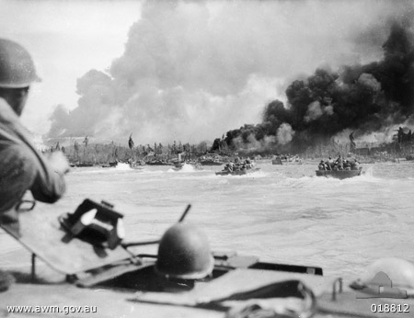
Island-Hopping Warfare
American and Australian troops land in Borneo

Slide 26
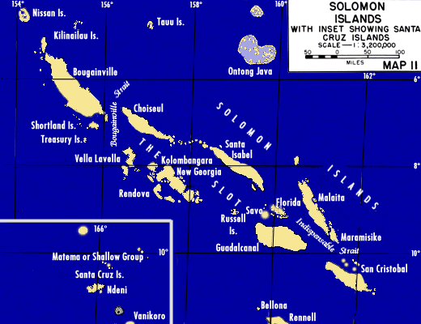
"Island Hopping"

Slide 27
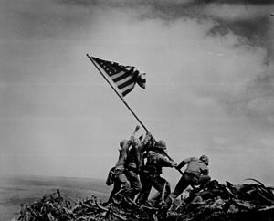
Iwo Jima and Okinawa
Iwo Jima February- March 1945- Significant because allows bombing missions on main land Japan
Okinawa April-June 1945-The island where an invasion of Japan could start from. Heavy causalities.

Slide 28
The Battle of Okinawa
http://www.youtube.com/watch?v=UXvtDi9a1Oc

Slide 29
Kamikaze.
Kamikaze- ‘Divine Wind’.
It became obvious that the US possessed more and better war technology
In desperation Japan ordered her young men to beat the enemy by flying bombs into the enemy (and dying in the process)
These suicide bombers flew planes, or manned suicide torpedoes.

Slide 30
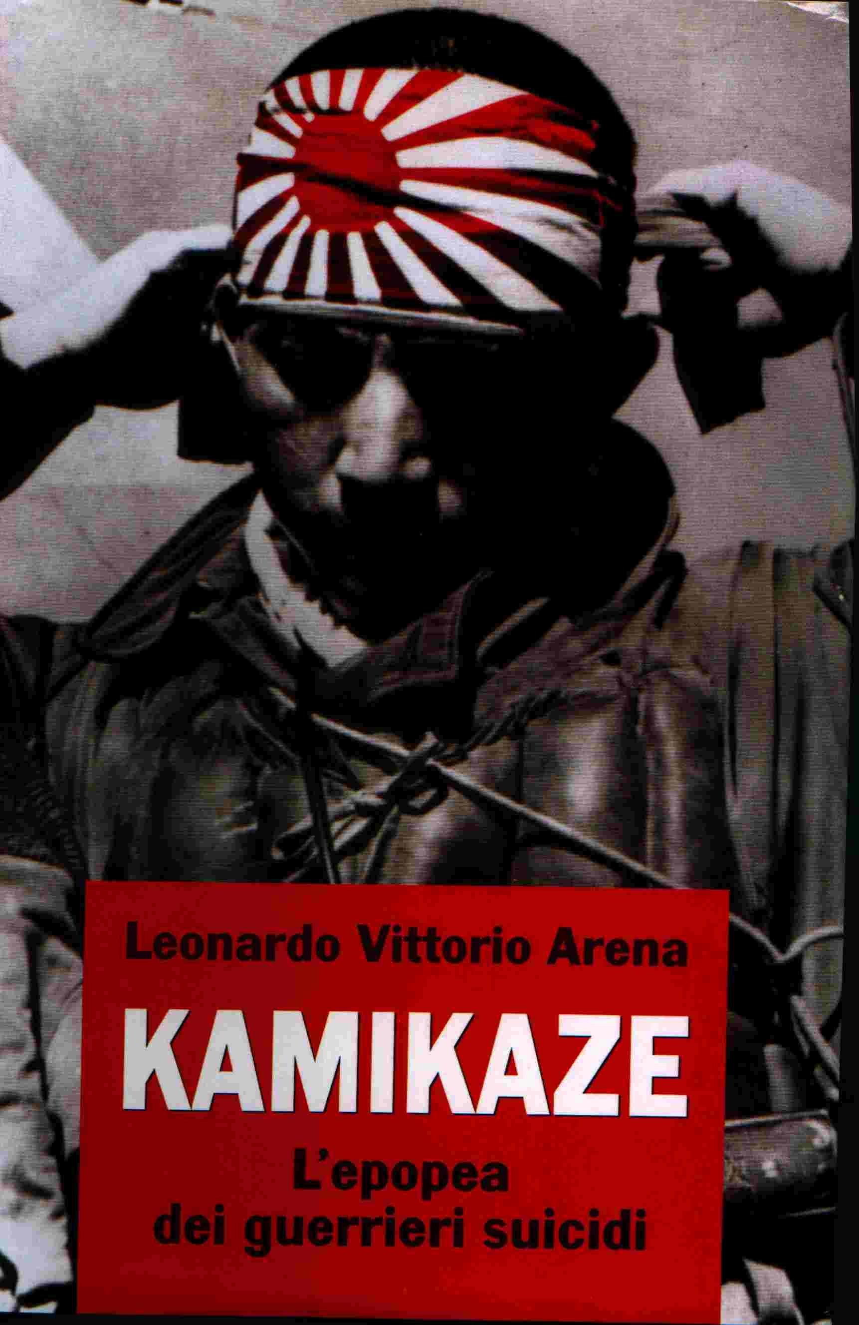
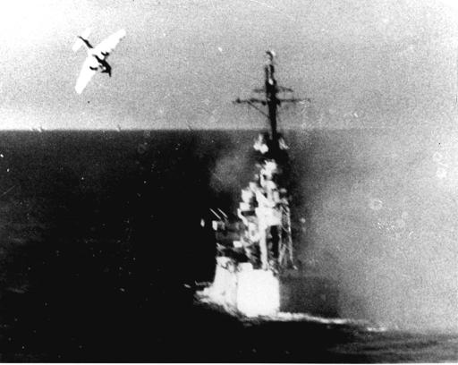

Slide 31
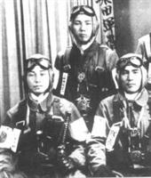

Slide 32
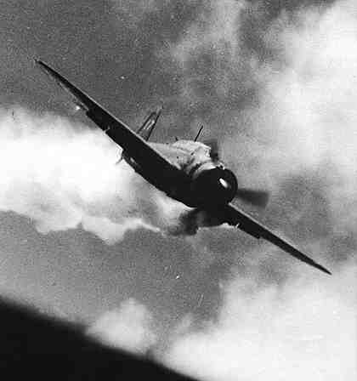

Slide 33
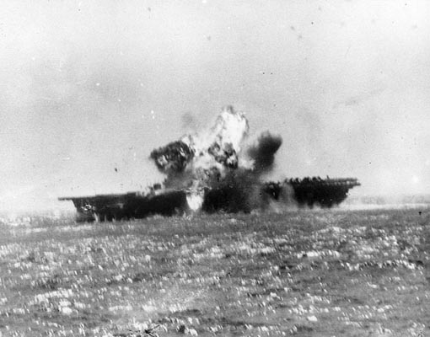
The US carrier St.Lo, attacked and sunk by Kamikaze.

Slide 34
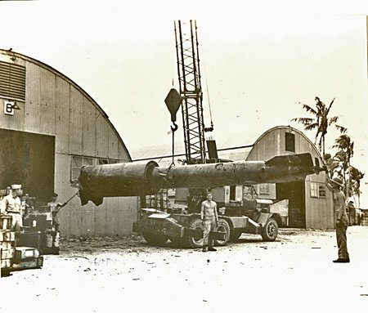
A ‘Kaiten’-or suicide torpedo.

Slide 35
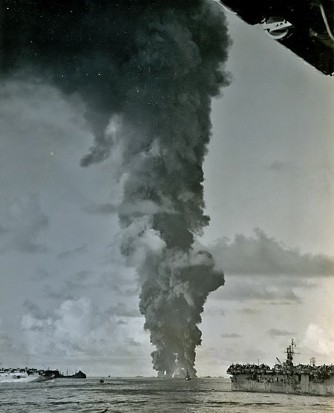
US ships ablaze after kamikaze attacks

Slide 36
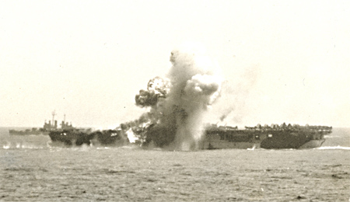
Another Kamikase hit on a US carrier.
A US sailor commented ‘the fight might be tough on land, but you can’t dig foxholes in the sea’!
What do you think he meant?

Slide 37
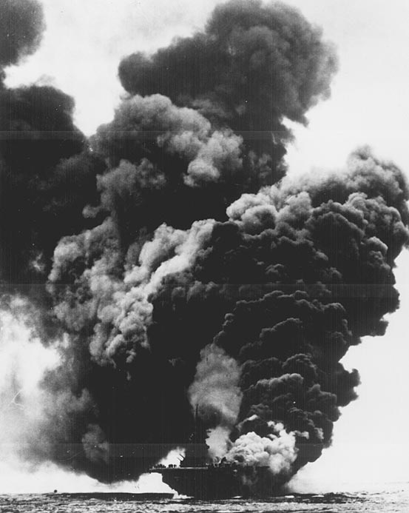
Another US ship in flames.
But replacements were already on there way.

Slide 38
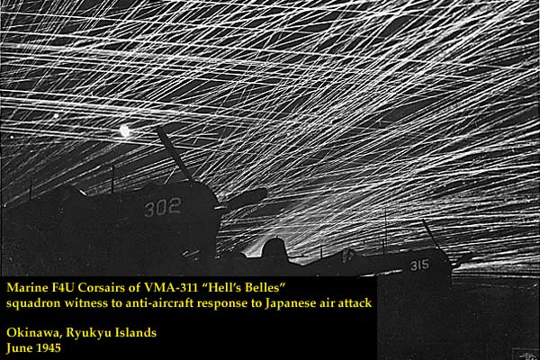
US anti-aircraft fire became monstrous.
Kamikase attacks occurred all day and all night.
Nerves were worn to shreds as combatants were unable to rest.

Slide 39
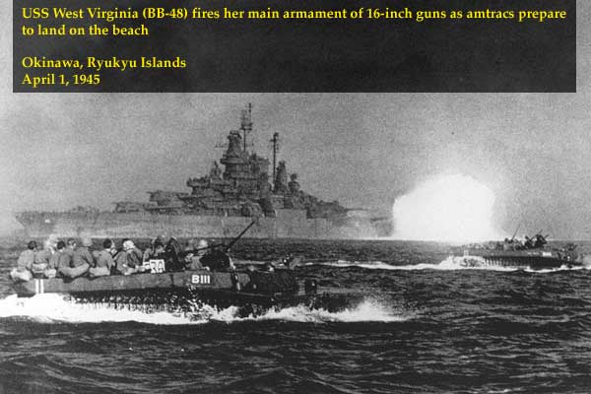
Attacking Okinawa island.

Slide 40
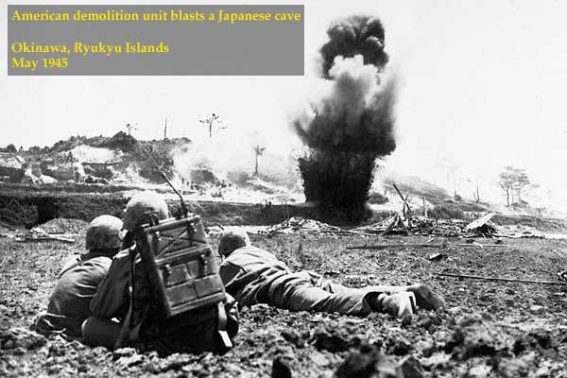
Okinawa Island - May 1945
This island is within bomber range of Japan. If it falls Japan will, at last, be vulnerable.

Slide 41
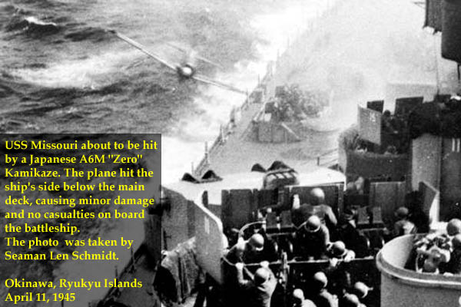
Kamikase attacks reach their peak.
Even the Yamato battleship is sent on a suicide mission (and is sunk)

Slide 42
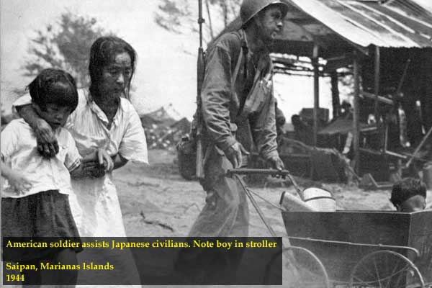
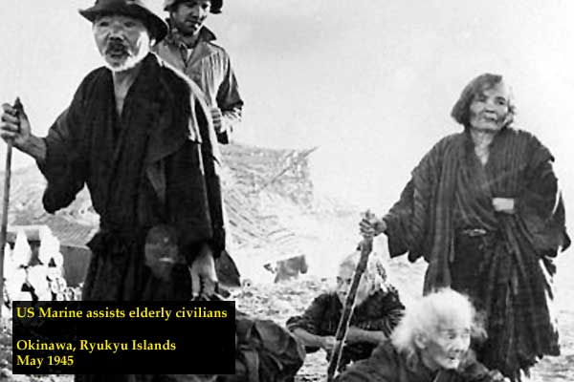
Civilians caught up in the fighting

Slide 43
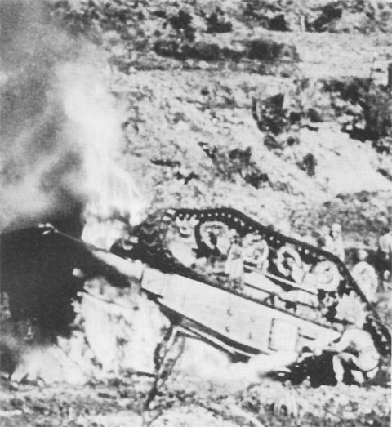
A US soldier uses a flamethrower
A US tank lies upsidedown after being blown up

Slide 44
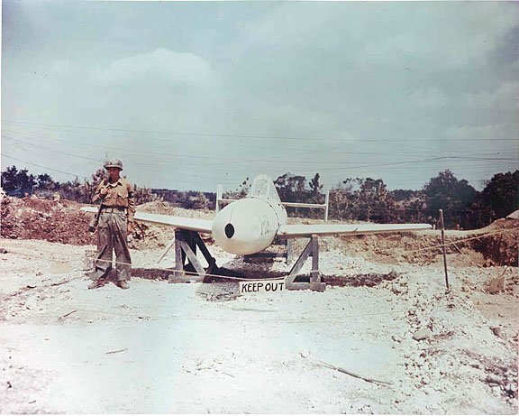
The ‘Ohka’
This is an unused Japanese suicide rocket bomb found on Okinawa. There were no more Japanese planes to launch it.

Slide 45
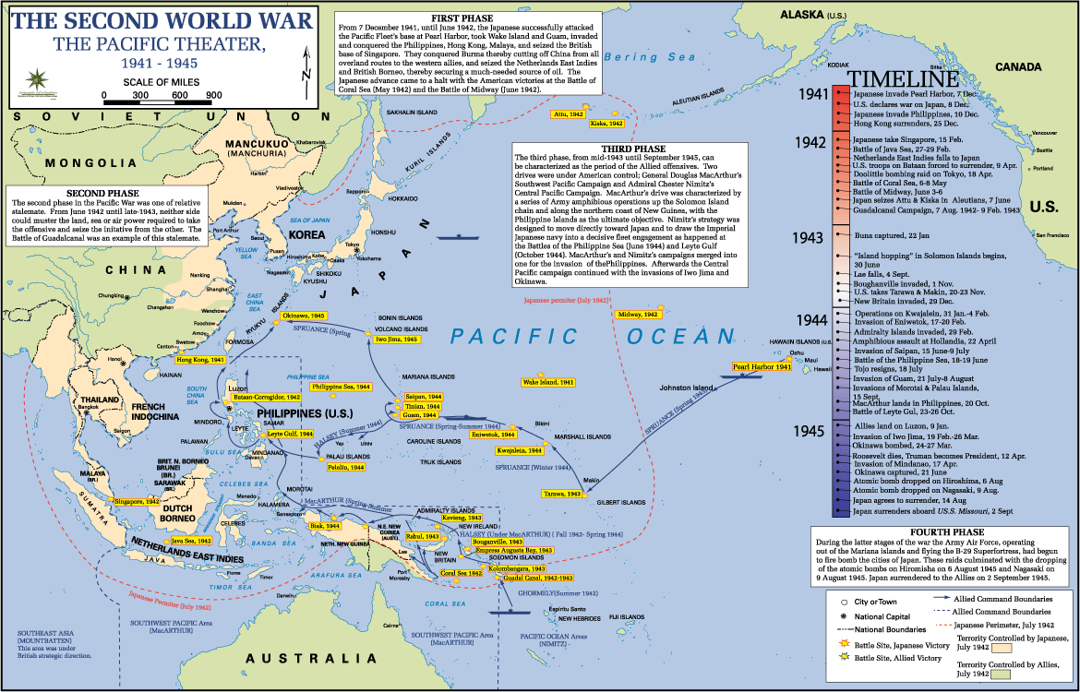

Slide 46
The Manhattan Project
Research of the bomb begins early in 1941
Very secretive program, Vice-President Truman didn’t know about the program until he became president after Roosevelt’s death.
At the height of construction in mid 1944, the Project employed nearly 129,000 people. No other nation in the world had the massive industrial capacity to make this possible.
The first nuclear test was located near Alamogordo, New Mexico, under code name “Trinity” on July 16, 1945.

Slide 47
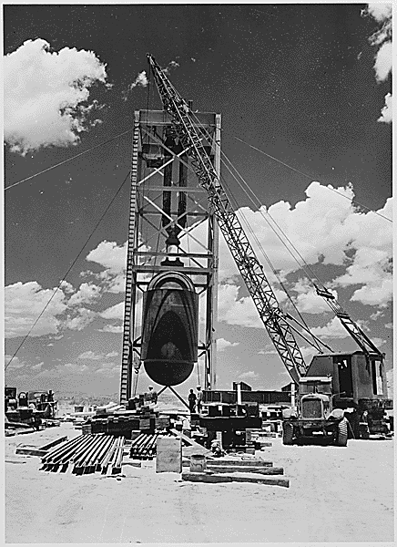
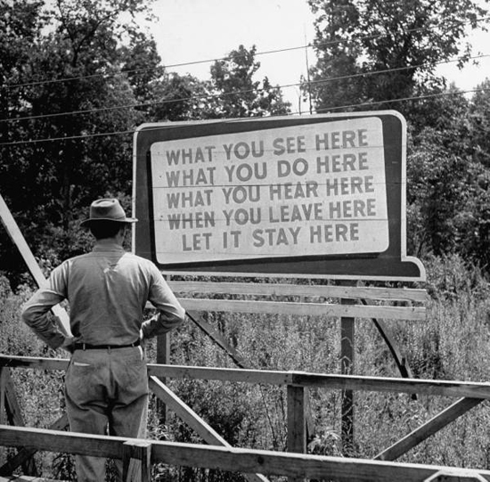

Slide 48
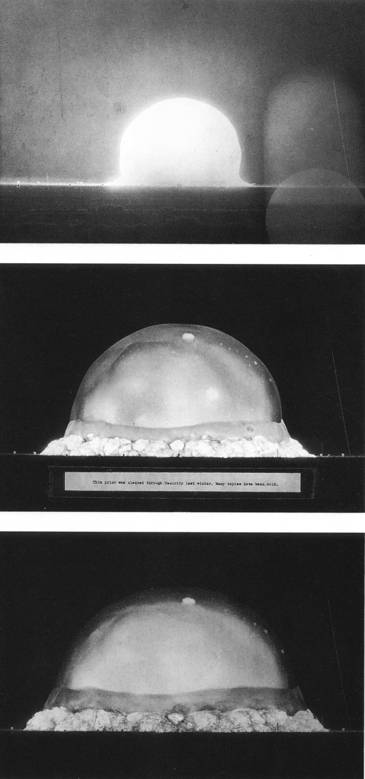

Slide 49
Hiroshima and Nagasaki
Truman had to decide whether to use the bomb or invade Japan. Projected casualties for invasion were high.
August 6, 1945- The United States dropped atomic bomb over Hiroshima killing over 100,000 people
August 9, 1945- The United States dropped another atomic bomb over Nagasaki killing over 60,000 people

Slide 50
http://www.youtube.com/watch?v=d3oSS_FP-cA
http://www.youtube.com/watch?v=NF4LQaWJRDg

Slide 51
The Atomic Bomb
The first Atomic bomb to be used in war… ‘little boy’.
This bomb was shipped from the US a mere 4 hours after the ‘Trinity’ A-bomb test in the US.
The actual radioactive material inside was the size of an orange.

Slide 52
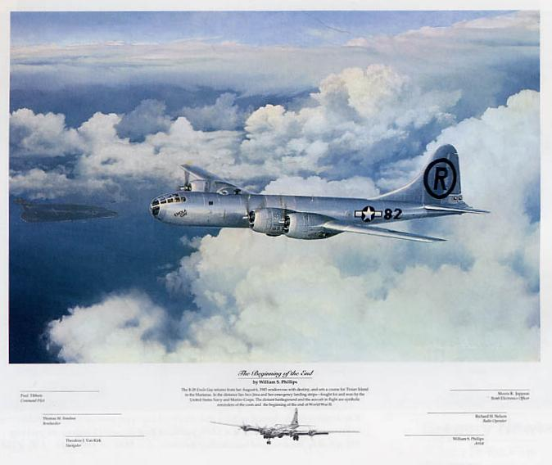
The Enola Gay. The US plane chosen to drop the Atomic bomb on Japan.

Slide 53
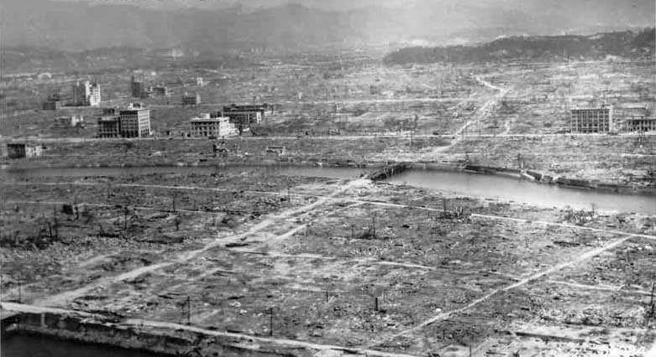
Hiroshima- Aug 6 1945
The effect of ‘little boy’

Slide 54
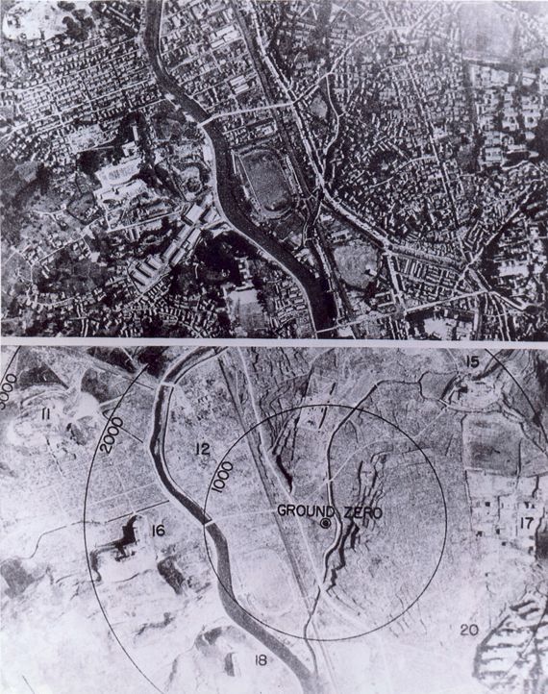
Nagasaki
Aug 10 1945.
Atomic Bomb number 2.

Slide 55
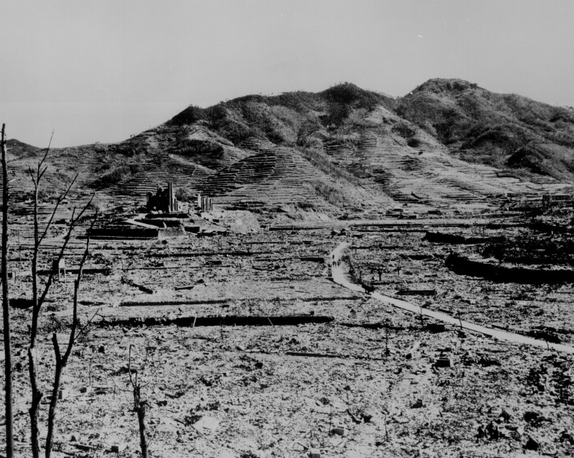
This had once been Nagasaki.

Slide 56
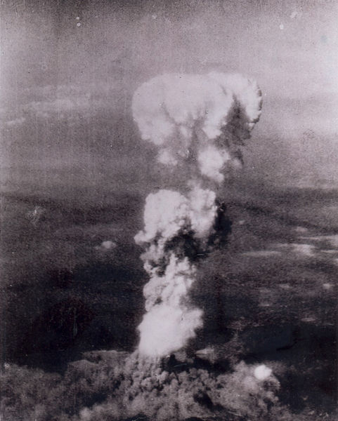
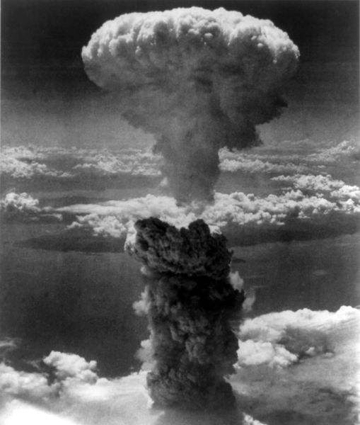
Nuclear Strikes
Aug 6, 1945. Uranium bomb “Little Boy” dropped on Hiroshima, killing 140,000
Aug 9, 1945. Plutonium bomb “Fat Man” dropped on Nagasaki, killing 74,000

Slide 57
Radiation
The defining characteristic of an atomic bomb that distinguishes it from any conventional bomb is radiation.
Those exposed within about 1000 meters of the hypocenter received life-threatening doses, and most died within a few days.
Decades later, that radiation was still producing harmful aftereffects. Leukemia and other cancers appeared over the course of 2 to 20 years, and radiation effects still threaten the health of the survivors.

Slide 58
Black Rain
Soon after the explosion, a giant mushroom cloud billowed upward, carrying dirt, dust, and other debris high into the air. After the explosion, soot generated by the conflagration was carried by hot air high into the sky. this dust and soot became radioactive, mixed with water vapor in the air, then fell back to earth in what came to be called "black rain.“
The black rain contained radioactive material. Fish died and floated to the surface in the ponds and rivers where this rain fell. Many of the people who drank from wells in areas where the black rain fell suffered from diarrhea for three months.

Slide 59
Keloids
Scars left by exposure to heat and radiation erupted 2-3 years after the blast

Slide 60
Cataracts
The patient was exposed 820m from the hypocenter and had white cloudiness in both eyes. The dark area in the center of this photo is the cloudiness caused by an A-bomb cataract.
Cataracts occurred several months to several years after exposure.

Slide 61
The Blast Pressure
The wind velocity on the ground beneath the explosion center was 980 miles/hr, which is five times stronger than the wind generated by strong hurricanes

Slide 62
Heat
Within 0.3 seconds of detonation, the fireball high in the air grew to a diameter of more than 200 meters. The temperature on the surface was 7,000 degrees C.
The heat rays released by that fireball devastated the people and things below.

Slide 63
Human Shadow Etched in Stone
A person sitting on the bank steps waiting for it to open was exposed to the flash from the atomic bomb explosion. Receiving the rays directly from the front, the victim undoubtedly died on the spot from massive burns. The surface of the surrounding stone steps was turned whitish by the intense heat rays. The place where the person was sitting remained dark like a shadow

Slide 64
Pictures

Slide 65
Fire
When the atomic bomb detonated, houses at or near the hypocenter ignited all at once. Flames leapt up quickly throughout the city. For the next 3 days, the city burned. Within a radius of two kilometers, all combustible material was burned and the thousands of people trapped under collapsed buildings were burned to death.

Slide 66
Relief
The atomic bomb instantaneously destroyed the Prefectural government offices, City Hall, the police stations, and all government buildings.
The next day, the Army Marine Headquarters (commonly known as the Akatsuki Corps), which sustained only slight damage, took the lead in establishing the Hiroshima Security Regiment Headquarters.
The military, the government, and the people united to carry out relief activities, often with little understanding of the effects of radiation.

Slide 67
Summary

Slide 68
Atomic Bomb Paragraphs
Directions: You and your partner are going to get a packet of different perspectives on America using the atomic bombs. Please do not write on the packet. Using the information in the packet you are going to going to write a paragraph (5 complete sentences) for each of the questions:
1. Why did the United States decide to use the atomic bombs? What reasons are given in the sources?
Why do some people say that the United States did not need to use the bombs? What reasons do they give?
What do you think about the United States using the atomic bombs? Did they make the right or wrong decision? What alternatives could they have used?

Slide 69
Interactive Notebook Catch-up
If you are missing anything in your interactive notebook, finish it.
If you are done with your interactive notebook, help someone who is not finished.
You have the rest of the period.

